Slide 1

Introduction to Linux
Mina Gabriel

Slide 2
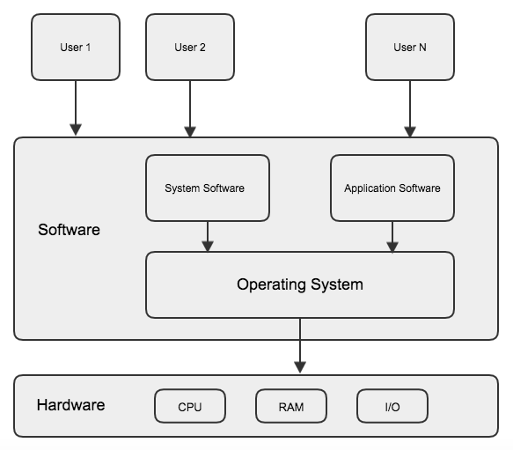
What is Operating Systems? OS
An operating system is a program that acts as an interface between the user and the computer hardware and controls the execution of all kinds of programs.

Slide 3
Important functions of Operating System
Memory Management •
Processor Management •
Device Management

Slide 4
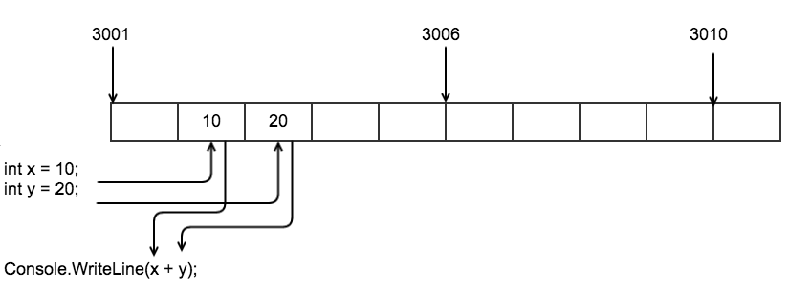
Memory Management
Memory management is the act of managing computer memory at the system level. The essential requirement of memory management is to provide ways to dynamically allocate portions of memory to programs at their request, and free it for reuse when no longer needed.

Slide 5
Processor Management
In multiprogramming environment, OS decides which process gets the processor when and how much time. This function is called process scheduling. Operating System does the following activities for processor management.
•
Keeps tracks of processor and status of process. Program responsible for this task is known as traffic controller. •
Allocates the processor (CPU) to a process. •
De-allocates processor when processor is no longer required.

Slide 6
Device Management
OS manages device communication via their respective drivers. Operating System does the following activities for device management.
Keeps tracks of all devices. Program responsible for this task is known as the I/O controller.
Decides which process gets the device when and for how long.
Allocates the device.
De-allocates devices.

Slide 7
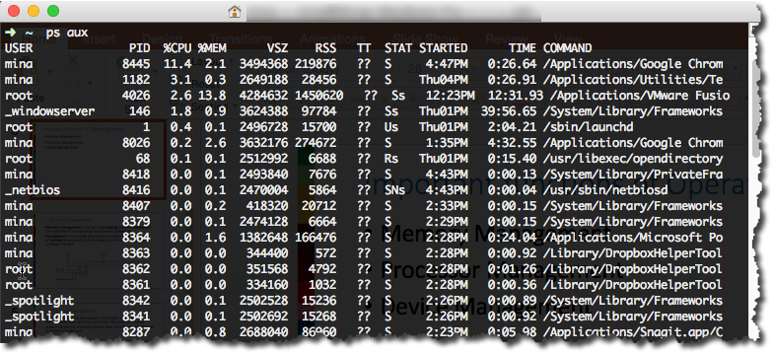
Process
process is an instance of a program running in a computer. It is close in meaning to task , a term used in some operating systems. In UNIX and some other operating systems, a process is started when a program is initiated.

Slide 8
Unix History
In the late 1960s, researchers from General Electric, MIT and Bell Labs launched a joint project to develop an ambitious multi-user, multi-tasking OS for mainframe computers known as MULTICS (Multiplexed Information and Computing System)
MULTICS failed.
But it did inspire Ken Thompson, who was a researcher at Bell Labs, to have a go at writing a simpler operating system himself.

Slide 9
He wrote a simpler version of MULTICS called his attempt UNICS (Uniplexed Information and Computing System).
Because memory and CPU power were at a premium in those days, UNICS (eventually shortened to UNIX) used short commands to minimize the space needed to store them and the time needed to decode them - hence the tradition of short UNIX commands we use today, e.g. ls, cp, rm, mv etc.

Slide 10
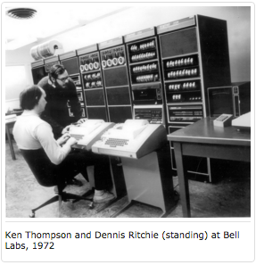
Ken Thompson then teamed up with Dennis Ritchie, the author of the first C compiler in 1973. They rewrote the UNIX kernel in C - this was a big step forwards in terms of the system's portability - and released the Fifth Edition of UNIX to universities in 1974.

Slide 11
Linux
Linux is a free open source UNIX OS for PCs that was originally developed in 1991 by Linus Torvalds, a Finnish undergraduate student.
The open source nature of Linux means that the source code for the Linux kernel is freely available so that anyone can add features and correct deficiencies. This approach has been very successful and what started as one person's project has now turned into a collaboration of hundreds of volunteer developers from around the globe.

Slide 12
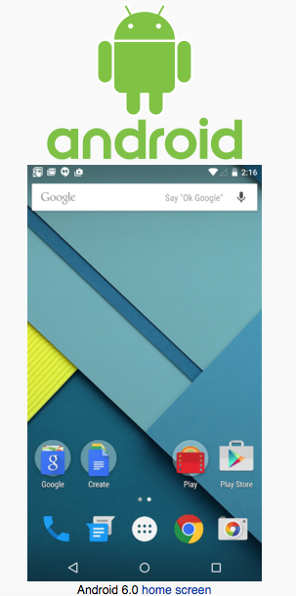
Android is Linux Based OS
Android is an Operating System build based on Linux Kernel

Slide 13
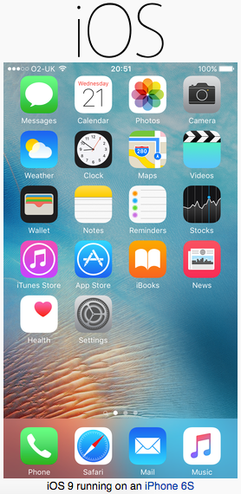
iPhone IOS
IOS is a mobile operating system developed by Apple based on UNIX

Slide 14
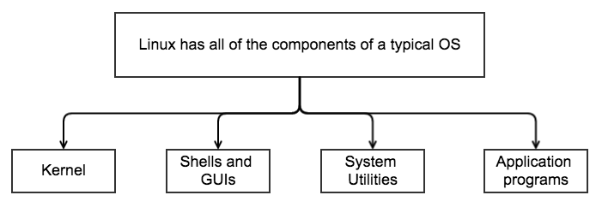
Architecture of the Linux Operating System

Slide 15
Kernel
the kernel is a computer program that manages input output requests from software, and translates them into data processing instructions for the central processing unit and other electronic components of a computer. The kernel is a fundamental part of a modern computer's operating system.

Slide 16
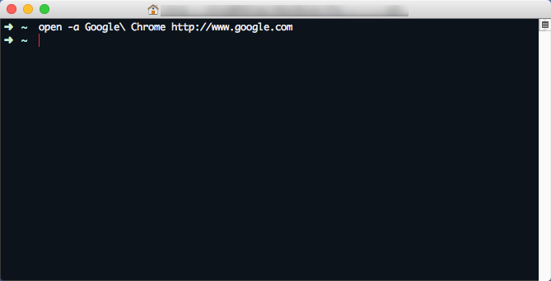
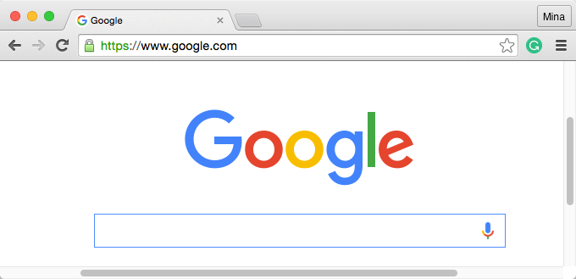
Shells and GUIs
Linux supports two forms of command input: through textual command line shells similar to those found on most UNIX systems and through graphical interfaces (GUIs) such as the KDE and GNOME window managers.

Slide 17
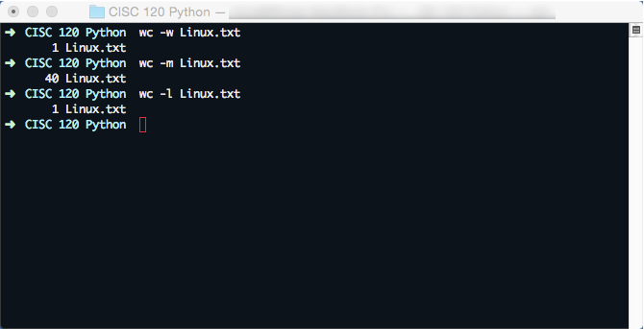
System Utilities
Virtually every system utility that you would expect to find on standard implementations of UNIX has been ported to Linux.
These system utilities are designed to be powerful tools that do a single task extremely well (e.g. grep finds text inside files while wc -word count- counts the number of words, lines and bytes inside a file). Users can often solve problems by interconnecting these tools instead of writing a large monolithic application program.

Slide 18
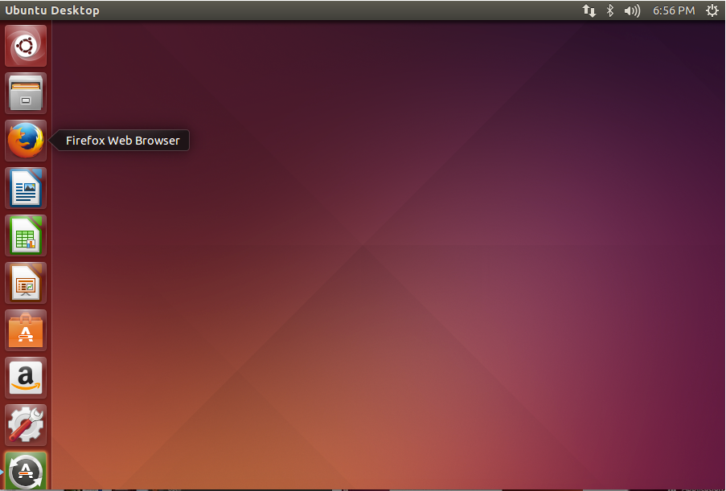
Application programs
Linux distributions typically come with several useful application programs as standard. Examples include:

Slide 19
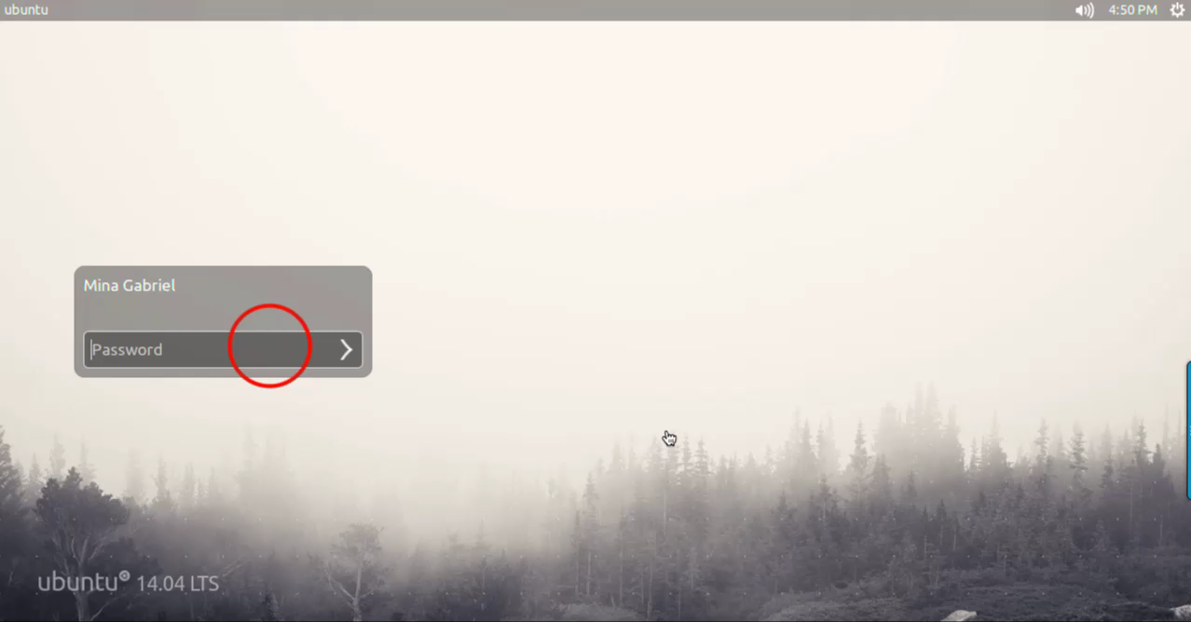
Log on a Linux machine

